Slide 1


4조asdasdasd
빅데이터 청년인재 고려대학교 – 4조

Slide 2
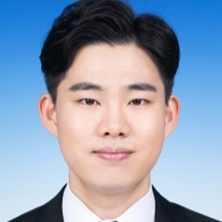
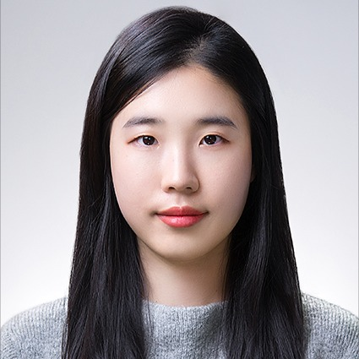
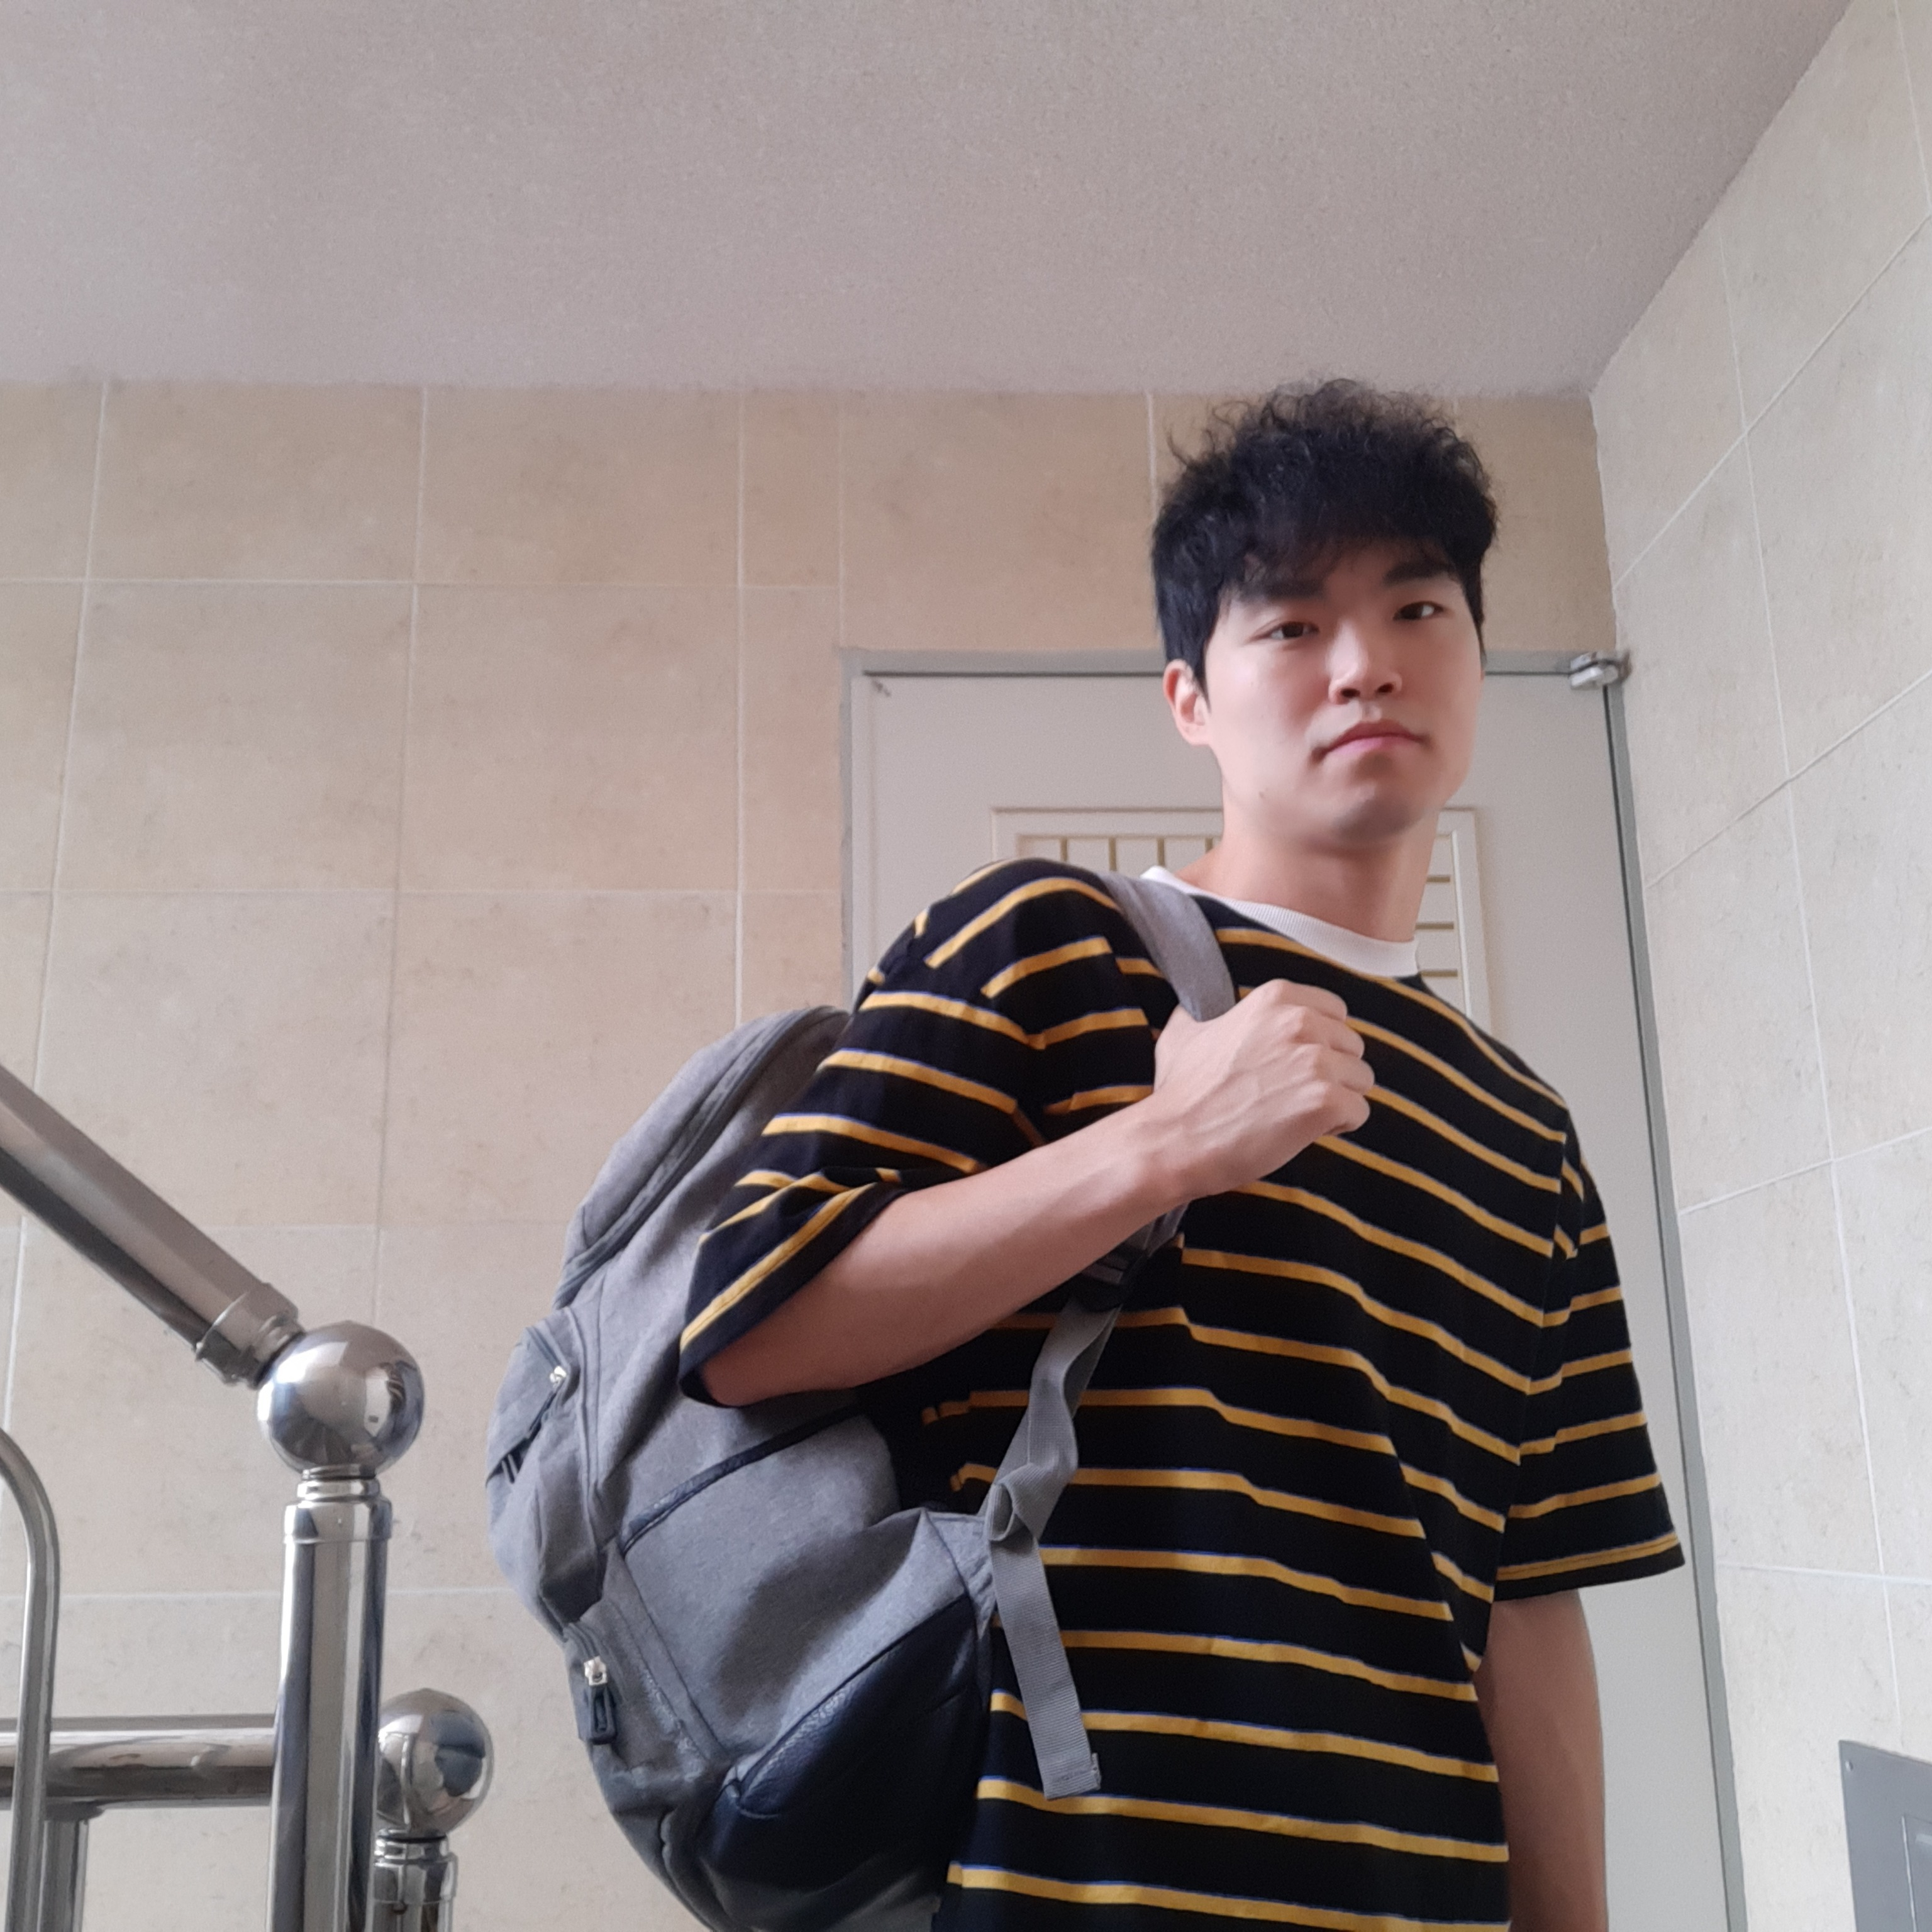
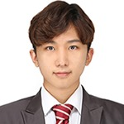
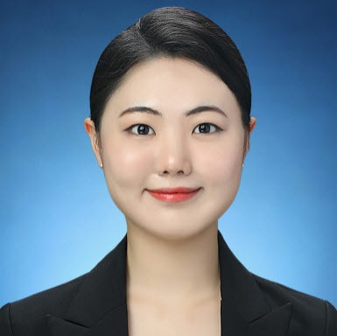
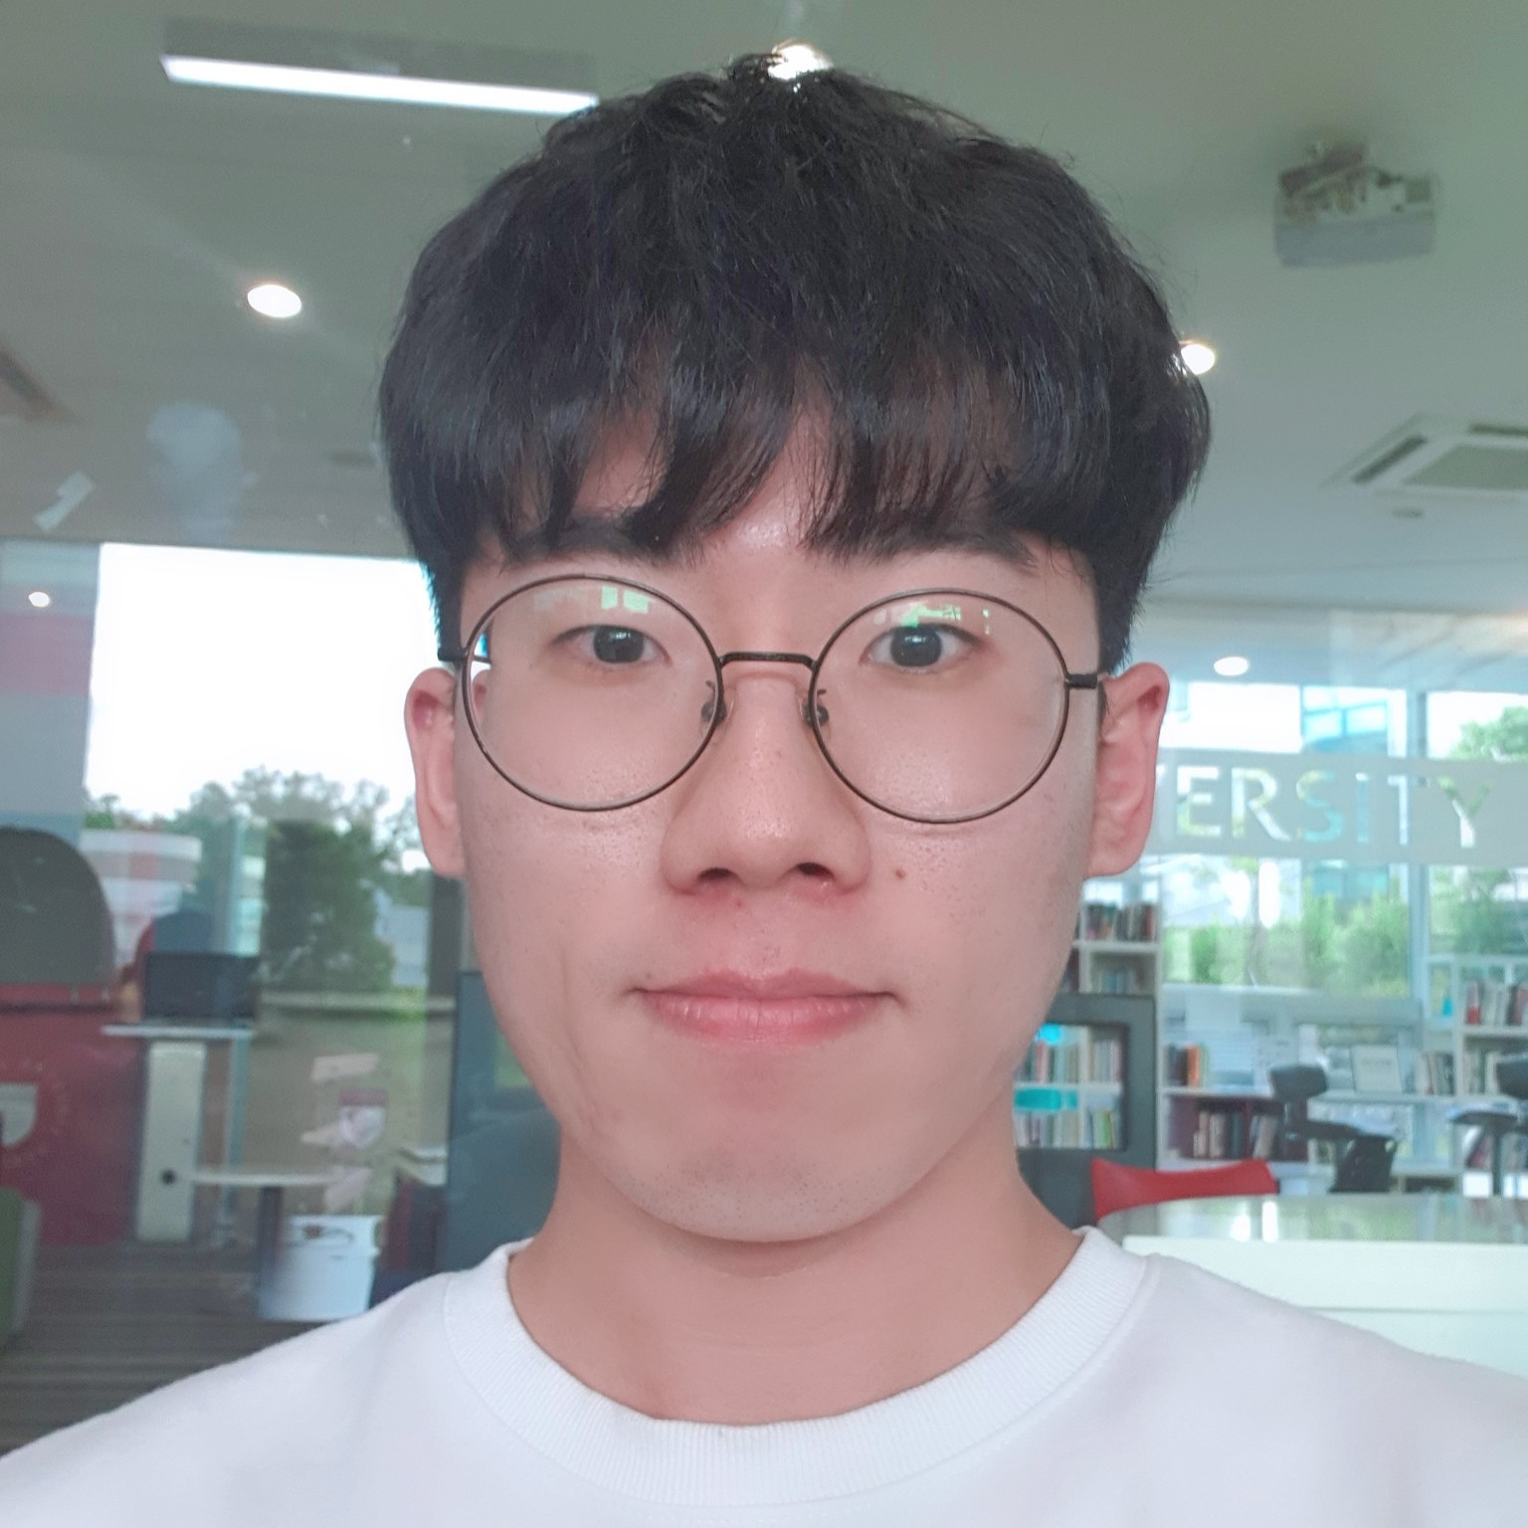
TEAM MEMBER
빅데이터 청년인재 고려대학교 - 4조
박정운
Enjoy your stylish business and
campus life with BIZCAM
박채림
Enjoy your stylish business and
campus life with BIZCAM
박현종
Enjoy your stylish business and
campus life with BIZCAM
심재준
Enjoy your stylish business and
campus life with BIZCAM
정효희
Enjoy your stylish business and
campus life with BIZCAM
황준식
Enjoy your stylish business and
campus life with BIZCAM

Slide 3
POWER POINT PRESENTATION
Enjoy your stylish business and campus life with BIZCAM
CONTENT
A
CONTENTS A
컨텐츠에 대한 내용을 적어요
Enjoy your stylish business and campus life with BIZCAM
CONTENT
CONTENT
A
CONTENTS A
컨텐츠에 대한 내용을 적어요
Enjoy your stylish business and campus life with BIZCAM
CONTENT
CONTENT
A
CONTENT
CONTENTS A
컨텐츠에 대한 내용을 적어요
Enjoy your stylish business and campus life with BIZCAM

Slide 4
POWER POINT PRESENTATION
Enjoy your stylish business and campus life with BIZCAM
CONTENT
A
CONTENTS A
컨텐츠에 대한 내용을 적어요
Enjoy your stylish business and campus life with BIZCAM
CONTENT
CONTENT
A
CONTENTS A
컨텐츠에 대한 내용을 적어요
Enjoy your stylish business and campus life with BIZCAM
CONTENT
CONTENT
A
CONTENT
CONTENTS A
컨텐츠에 대한 내용을 적어요
Enjoy your stylish business and campus life with BIZCAM

Slide 5
POWER POINT PRESENTATION
Enjoy your stylish business and campus life with BIZCAM
CONTENT
A
A
CONTENTS A
컨텐츠에 대한 내용을 적어요
Enjoy your stylish business and campus life with BIZCAM
CONTENTS A
컨텐츠에 대한 내용을 적어요
Enjoy your stylish business and campus life with BIZCAM
A
A
CONTENTS A
컨텐츠에 대한 내용을 적어요
Enjoy your stylish business and campus life with BIZCAM
CONTENTS A
컨텐츠에 대한 내용을 적어요
Enjoy your stylish business and campus life with BIZCAM
CONTENT
CONTENT
CONTENT
PowerPoint is a computer program created by Microsoft Office
Microsoft Office PowerPoint is the presentation program
used the most in the world.
You can use a software program such as Microsoft Power Point to provide the audience with slides that contains your major points or essential information.
CONTENT
CONTENT

Slide 6
POWER POINT PRESENTATION
Enjoy your stylish business and campus life with BIZCAM
CONTENT
CONTENT
컨텐츠에 대한 내용을 적어요
Enjoy your stylish business and campus life with BIZCAM
CONTENTS A
CONTENTS
CONTENT
CONTENTS A
CONTENTS A
CONTENT
CONTENT
컨텐츠에 대한 내용을 적어요
Enjoy your stylish business and campus life with BIZCAM
컨텐츠에 대한 내용을 적어요
Enjoy your stylish business and campus life with BIZCAM
CONTENT

Slide 7
POWER POINT PRESENTATION
Enjoy your stylish business and campus life with BIZCAM
CONTENT
CONTENT
컨텐츠에 대한 내용을 적어요
Enjoy your stylish business and campus life with BIZCAM
CONTENTS A
CONTENTS
CONTENT
CONTENTS A
CONTENTS A
CONTENT
CONTENT
컨텐츠에 대한 내용을 적어요
Enjoy your stylish business and campus life with BIZCAM
컨텐츠에 대한 내용을 적어요
Enjoy your stylish business and campus life with BIZCAM
CONTENT

Slide 8
POWER POINT PRESENTATION
Enjoy your stylish business and campus life with BIZCAM
CONTENT
CONTENTS A
컨텐츠에 대한 내용을 적어요
Enjoy your stylish business and campus life with BIZCAM
CONTENT
CONTENT
CONTENTS A
컨텐츠에 대한 내용을 적어요
Enjoy your stylish business and campus life with BIZCAM
CONTENTS A
컨텐츠에 대한 내용을 적어요
Enjoy your stylish business and campus life with BIZCAM
CONTENTS A
컨텐츠에 대한 내용을 적어요
Enjoy your stylish business and campus life with BIZCAM
CONTENTS A
컨텐츠에 대한 내용을 적어요
Enjoy your stylish business and campus life with BIZCAM
CONTENT
CONTENTS A
컨텐츠에 대한 내용을 적어요
Enjoy your stylish business and campus life with BIZCAM
CONTENTS A
컨텐츠에 대한 내용을 적어요
Enjoy your stylish business and campus life with BIZCAM
CONTENT
CONTENT

Slide 9
POWER POINT PRESENTATION
Enjoy your stylish business and campus life with BIZCAM
CONTENT
CONTENT
CONTENTS 30%
CONTENTS 35%
CONTENT
CONTENTS A
컨텐츠에 대한 내용을 적어요
Enjoy your stylish business and campus life with BIZCAM
CONTENTS A
컨텐츠에 대한 내용을 적어요
Enjoy your stylish business and campus life with BIZCAM
CONTENT
POWER POINT PRESENTATION
CONTENTS 7%
CONTENT
CONTENTS 8%
CONTENTS 20%
CONTENT

Slide 10
POWER POINT PRESENTATION
Enjoy your stylish business and campus life with BIZCAM
CONTENT
CONTENT
75%
CONTENT
CONTENTS A
컨텐츠에 대한 내용을 적어요
Enjoy your stylish business and campus life with BIZCAM
CONTENT
57%
CONTENT
CONTENTS | CONTENTS | CONTENTS
PowerPoint | ○ | X
PowerPoint | △ | ○
PowerPoint | △ | ○
PowerPoint | ○ | X
35%
CONTENT

Slide 11
POWER POINT PRESENTATION
Enjoy your stylish business and campus life with BIZCAM
CONTENT
CONTENT
CONTENT
CONTENT
CONTENT
CONTENT

Slide 12
POWER POINT PRESENTATION
Enjoy your stylish business and campus life with BIZCAM
CONTENT
CONTENT
CONTENT
CONTENT
CONTENT
CONTENT
CONTENT

Slide 13
오늘 사용한 색상은?
R 247
G 235
B 235
R 95
G 208
B 212
R 84
G 88
B 113
2013 버전 이상 사용자께서는 스포이트 기능을 이용하시면 편하구요.
2010 이하 버전 사용자 께서는 다른 채우기 색 > 사용자 지정 탭 > RGB 색상 값 입력

